Slide 1
Final Project Presentation
Nina Kerr

Slide 2
Problem
Flood damage assessment project: building footprints need to be assigned to associated parcel it falls within in order for determine structure type, land value, and other variables associated with the parcel information available.
Issue: When assigning building footprints to parcels, some building footprints span multiple parcels making it difficult to easily determine what parcel the building footprint should be assigned to.

Slide 3
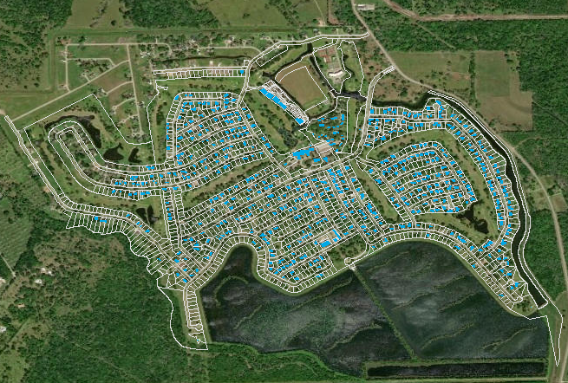
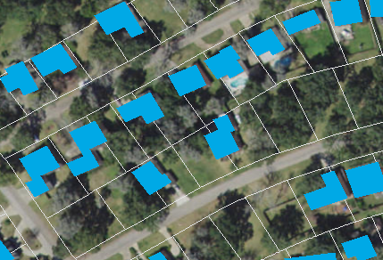

Slide 4

Solution
Create a script that can assign a parcel ID to each building footprint based on the largest area of the building footprint that falls within the parcel.
This BF would be assigned to this parcel
Not this one

Slide 5
Steps
1. Re-project shapefiles into same projection
2. Intersect parcels and building footprints
3. Recalculate area of building footprints
4. For each original BF ID:
Find Max area
Return parcel ID
Return BF ID and parcel ID to new list
5. Join to spatial dataframe

